Slide 1
Constraint Satisfaction
Chen-Yu Wei

Slide 2
Revised Assignment Policies
7 free late days (originally 5)
Late days for each homework cannot exceed 7
We will release / discuss solutions one week after the deadline
Exception: Homework3.choices does not allow any late submission.
Further extensions are made in very rare cases
Doctor proof or proof of emergency is required
We count the late days for the choices part and programming part separately
Each part has 7 free late days
Need NOT notify me when you want to use free late days

Slide 3
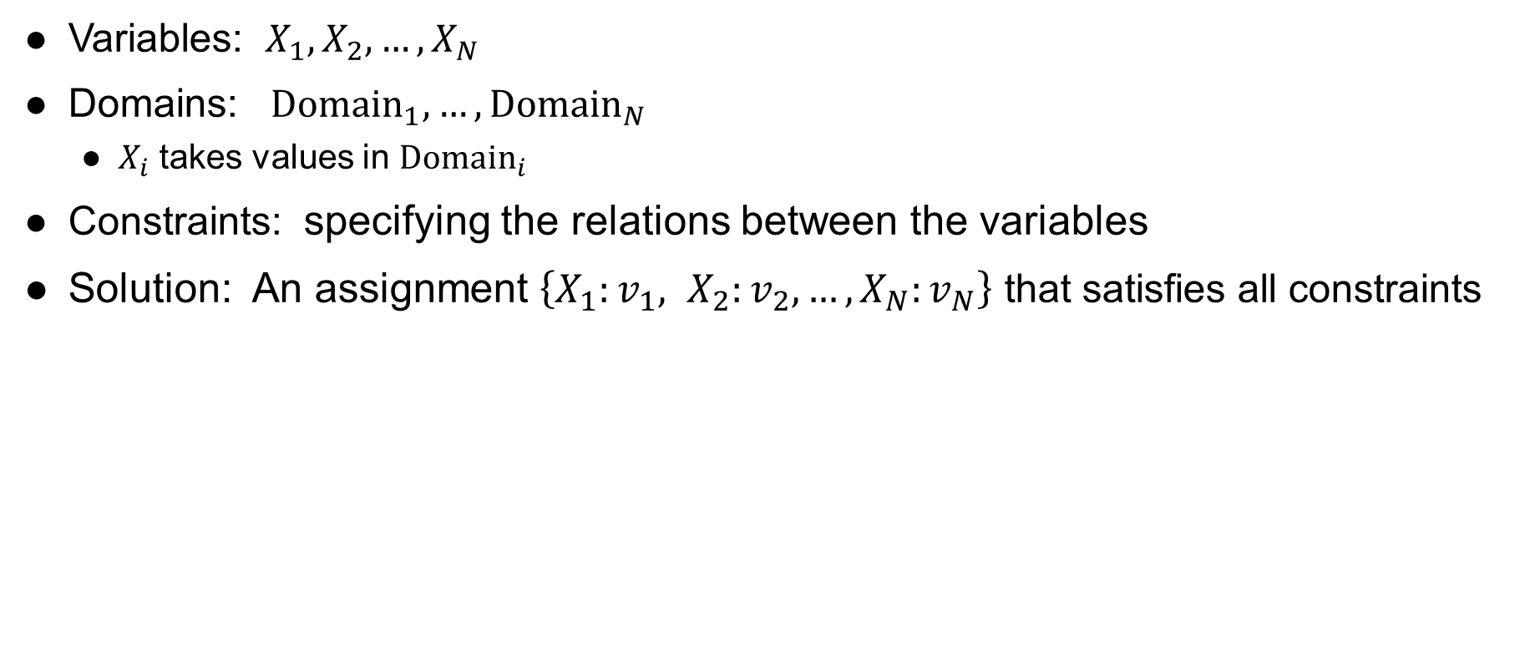
Constraint Satisfaction Problems (CSP)
Variables: $X_{1}, X_{2}, …, X_{N}$
Domains: ${Domain}_{1}, …, {Domain}_{N}$
$X_{i}$ takes values in ${Domain}_{i}$
Constraints: specifying the relations between the variables
Solution: An assignment $\left\{X_{1}:v_{1}, X_{2}:v_{2}, …, X_{N}:v_{N}\right\}$ that satisfies all constraints

Slide 4

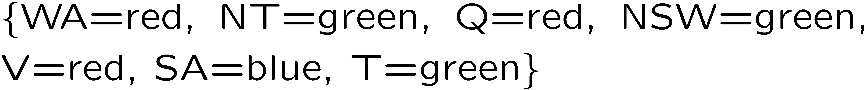
Example: Map Coloring
Variables:
Domains:
Constraints: adjacent regions must have different colors
Solutions are assignments satisfying all constraints, e.g.:
Implicit:
Explicit:

Slide 5

Example: Cryptarithmetic
Variables:
Domains:
Constraints:
Notes:
0=7, R=4, W=6, U=2, T=8, F=1; 867 + 867 = 1734

Slide 6
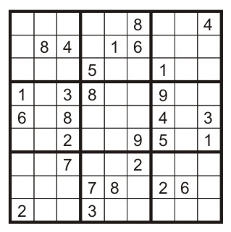
Example: Sudoku
Variables: Each (open) square
Domains: {1,2,…,9}
Constraints:
9-way alldiff for each column
9-way alldiff for each row
9-way alldiff for each region
(or can have a bunch of pairwise inequality constraints)

Slide 7
Real-World CSPs
Assignment problems: e.g., who teaches what class
Timetabling problems: e.g., which class is offered when and where?
Hardware configuration
Transportation scheduling
Factory scheduling
Circuit layout
…
Many real-world problems involve real-valued variables

Slide 8
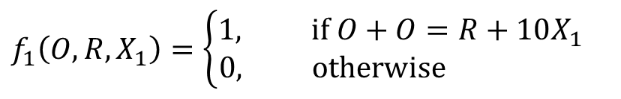
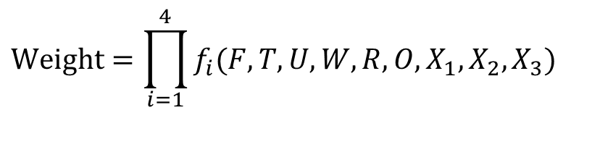
Factor Graph
Variable
Factor
$$Weight=\prod_{i=1}^{4}{f_{i}(F,T,U,W,R,O,X_{1},X_{2},X_{3})}$$
$$f_{1}\left(O,R,X_{1}\right)=\left\{\begin{aligned}1, if O+O=R+10X_{1} \\ 0, otherwise \end{aligned}\right.$$

Slide 9
Constraint Graph
constraint
Variable
(more convenient for binary constraint CSPs)
Every constraint involves at most 2 variables

Slide 10
How to Solve CSP?
Treat it as a search problem
Assign one variable at a time
State: A partial assignment
Action: Assign value to an unassigned variable
Goal test: check whether all constraint are satisfied
But there’s more structure to leverage
Variable ordering doesn’t matter
Variables are interdependent in a local way
We will start from known search algorithms, and try to speed it up

Slide 11



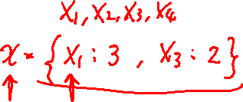

Backtracking Search
Backtracking search = DFS + failure-on-violation
BacktrackingSearch({ }, $Domain$) returns an assignment or reports failure.
BacktrackingSearch($x, Domain$):
If $x$ is a complete assignment: return $x$.
Let $X_{i}$ be the next unassigned variable.
For each value $v∈{Domain}_{i}$:
$x^{′}←x∪\left\{X_{i}:v\right\}$
If $x^{′}$ violates constraints: continue
return BacktrackingSearch($x^{′}$, $Domain$)
return failure

Slide 12
Improving Backtracking Search
Forward checking
Maintaining arc consistency (more powerful than forward checking)
Dynamic ordering

Slide 13
Vanilla Backtracking Search
Suppose we assign the variables in the order of
WA, Q, V, NT, NSW, SA
WA
NT
Q
NSW
V
SA
No valid assignment for SA.
Then the algorithm backtracks to try other assignments…

Slide 14
Forward Checking
Cross off values that violate a constraint when added to the existing assignment
WA
NT
Q
NSW
V
SA
Inconsistency found for SA (even though we haven’t reached the layer of SA).

Slide 15
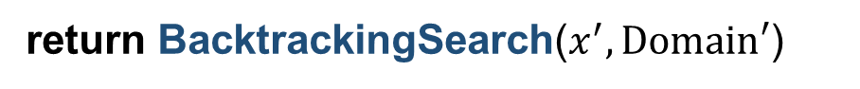

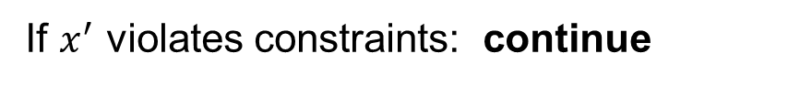
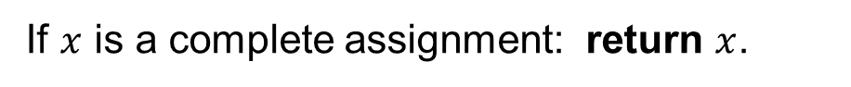
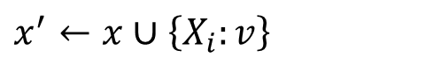


Forward Checking
BacktrackingSearch($x, Domain$):
If $x$ is a complete assignment: return $x$.
Let $X_{i}$ be the next unassigned variable.
For each value $v∈{Domain}_{i}$:
$x^{′}←x∪\left\{X_{i}:v\right\}$
If $x^{′}$ violates constraints: continue
return BacktrackingSearch($x^{′}, Domain′$)
return failure

Slide 16
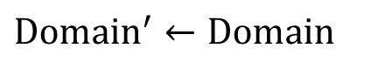



Forward Checking
BacktrackingSearch($x, Domain$):
If $x$ is a complete assignment: return $x$.
Let $X_{i}$ be the next unassigned variable.
For each value $v∈{Domain}_{i}$:
$x^{′}←x∪\left\{X_{i}:v\right\}$
${Domain}^{′}, Consistent=$ForwardChecking($x^{′}, X_{i}, v, Domain$)
If not $Consistent$: continue
return BacktrackingSearch($x^{′}, Domain′$)
return failure
ForwardChecking ($x^{′}, X_{i}, v, Domain$):
$${Domain}^{′}←Domain$$
For all $X_{j}$ that is unassigned in $x′$ and connected to $X_{i}$:
Delete values in ${Domain}_{j}^{′}$ that are inconsistent with $\left\{X_{i}:v\right\}$
If ${Domain}_{j}^{′}$ is empty: return ${Domain}^{′},False$
return ${Domain}^{′}, True$

Slide 17
Can We Prune Even More?
With forward checking:
WA
NT
Q
NSW
V
SA
After assigning Q with green, NT and SA’s domains are left with only blue.
But NT and SA are neighbors, so there is no consistent assignment from here.
How can we detect such inconsistency at this step?

Slide 18

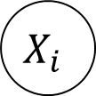
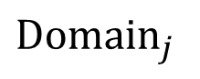
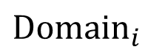
Arc Consistency
$$X_{i}$$
$$X_{j}$$
$${Domain}_{i}$$
$${Domain}_{j}$$
Fact. Let $v∈{Domain}_{i}$ be such that for all $w∈{Domain}_{j}$, $\left\{X_{i}:v, X_{j}:w\right\}$ violates the constraint on $(X_{i}, X_{j})$. Then we can remove $v$ from ${Domain}_{i}$.
Definition (Arc Consistency on $X_{i}→X_{j}$). For all $v∈{Domain}_{i}$, there is some $w∈{Domain}_{j}$ such that $\left\{X_{i}:v, X_{j}:w\right\}$ satisfies the constraint on $(X_{i}, X_{j})$.
Idea to prune more: keep checking whether we can remove elements from any Domain using the fact above. (i.e., always maintaining arc consistency)

Slide 19
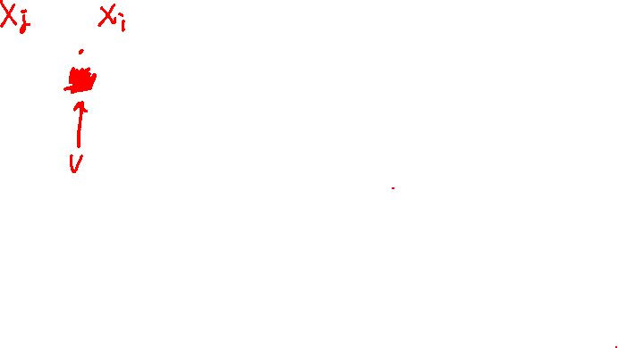
Maintaining Arc Consistency (MAC)
Forward checking: maintaining arc consistency from unassigned variables to newly assigned variables.
NT
Q
WA
SA
NSW
V

Slide 20

Maintaining Arc Consistency (MAC)
We can prune more if we ensure arc consistency for all arcs.
Remember: Delete from the tail!
NT
Q
WA
SA
NSW
V
If X’s domain changes, neighbors of X need to be rechecked!
Arc consistency detects failure earlier than forward checking.
What’s the downside of enforcing arc consistency?

Slide 21
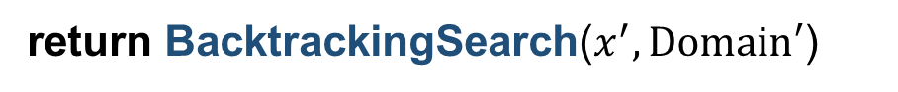


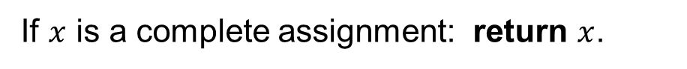
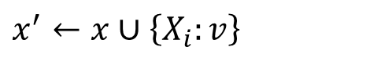


Maintaining Arc Consistency (MAC)
BacktrackingSearch($x, Domain$):
If $x$ is a complete assignment: return $x$.
Let $X_{i}$ be the next unassigned variable.
For each value $v∈{Domain}_{i}$:
$x^{′}←x∪\left\{X_{i}:v\right\}$
${Domain}^{′}, Consistent=$AC3($x^{′}, X_{i}, v, Domain$)
If not $Consistent$: continue
return BacktrackingSearch($x^{′}, Domain′$)
return failure

Slide 22


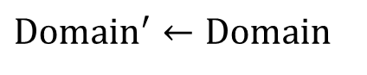


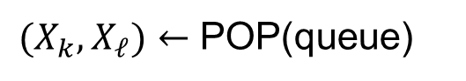
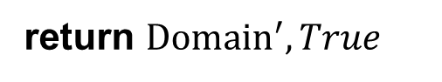
Maintaining Arc Consistency (MAC)
AC3($x^{′}, X_{i}, v, Domain$):
$${Domain}^{′}←Domain$$
queue $←$ {$\left(X_{j}, X_{i}\right)$ for all $X_{j}$ that is unassigned in $x^{′}$ and connected to $X_{i}$}
while queue not empty:
$(X_{k}, X_{ℓ})←$ POP(queue)
if arc $X_{k}→X_{ℓ}$ is not consistent:
Revise ${Domain}_{k}^{′}$ to make it consistent
if ${Domain}_{k}^{′}$ is empty: return ${Domain}^{′}, False$
for each $X_{m}≠X_{ℓ}$ that is unassigned in $x^{′}$ and connected to $X_{i}$:
add ($X_{m}, X_{k}$) to queue
return ${Domain}^{′}, True$

Slide 23

Video: Forward Checking

Slide 24
Video: Maintaining Arc Consistency

Slide 25
Improving Backtracking Search
Forward checking
Maintaining arc consistency (more powerful than forward checking)
Dynamic ordering

Slide 26
Ordering
BacktrackingSearch($x, Domain$):
If $x$ is a complete assignment: return $x$.
Let $X_{i}$ be the next unassigned variable.
Which variable should we pick first?
For each value $v∈{Domain}_{i}$:
Which value should we try first?
$x^{′}←x∪\left\{X_{i}:v\right\}$
${Domain}^{′}, Consistent=$AC3($x^{′}, X_{i}, v, Domain$)
If not $Consistent$: continue
return BacktrackingSearch($x^{′}, Domain′$)
return failure

Slide 27
Variable Ordering
WA
NT
Q
NSW
V
SA

Slide 28
Variable Ordering
Most Constrained Variable (MCV)
Choose variable that has the fewest left values in its domain.
Why?
Must assign every variable
If going to fail, fail early → more pruning

Slide 29
Value Ordering

Slide 30
Value Ordering
Least Constrained Value (LCV)
Choose the one that rules out the fewest values in the remaining variables.
Why?
Needs to choose some value
Choosing value most likely to lead to solution

Slide 31
Ordering
Most Constrained Variable (MCV)
Choose variable that has the fewest left values in its domain.
Must assign every variable
If going to fail, fail early → more pruning
Least Constrained Value (LCV)
Choose the one that rules out the fewest values in the remaining variables.
Needs to choose some value
Choosing value most likely to lead to solution

Slide 32
Homework 2
Xuhui Kang, Matthew Landers
Deadline: 11:59PM, September 30

Slide 33
Homework 2
Choice Questions (10 points)
10 questions.
Answer directly on Gradescope
The same requirements as the last time.
1 feedback box for the course
Program Questions (25 points)

Slide 34
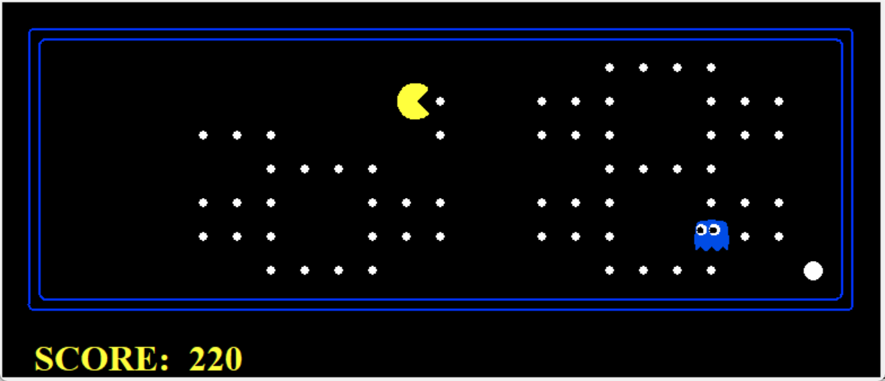
Question 1 (4 points): Reflex Agent
Your agent should easily and reliably clear the layout:
Run 10 times for evaluation:
TO receive full credits:
Wins all the 10 times
Average score is greater than 1k.

Slide 35
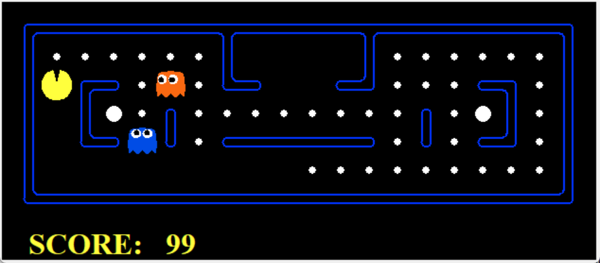
Question 2 (5 points): Minimax
You will write an adversarial search agent.
Work with any number of ghosts:
Check the number of ghosts first.
Index 0 is always the Pacman.
Correct implementation will lead to Pacman losing the game in some tests.
In large boards, Pacman will be good at not dying but bad at winning. It is not a problem.
When the Pacman believes that his death is unavoidable. Hw will try to end the game as soon as possible.

Slide 36
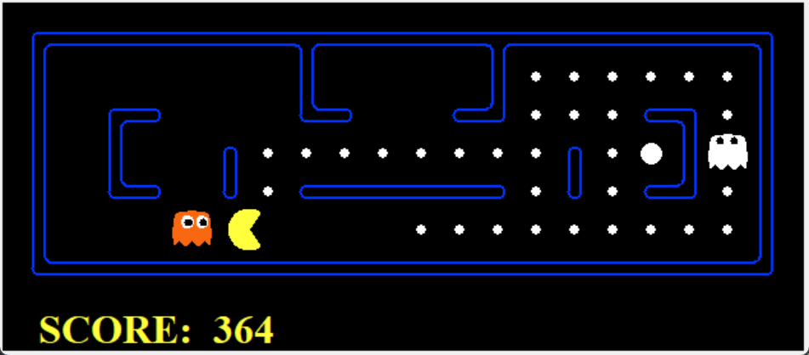
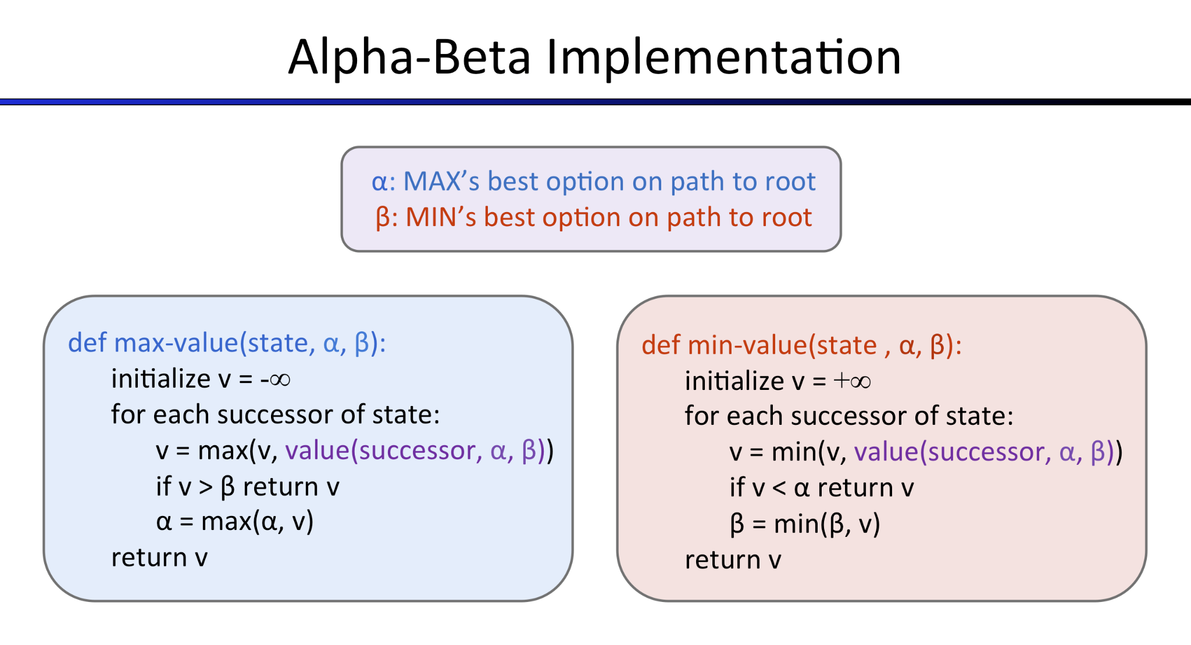
Question 3 (5 points): Alpha-Beta Pruning
Uses alpha-beta pruning to more efficiently explore the minimax tree.

Slide 37
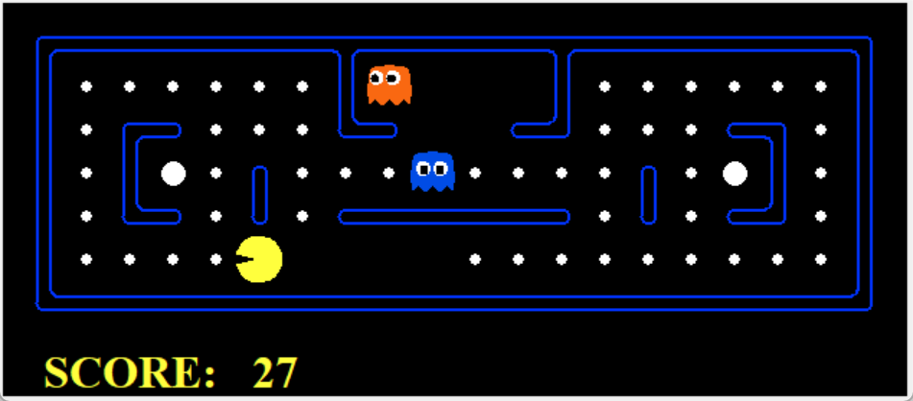
Question 4 (5 points): Expectimax
Implement Expectimax Agent to modeling the probabilistic behavior of agents who may make suboptimal choices.
Correct implementation will lead to Pacman losing the game in some tests.

Slide 38
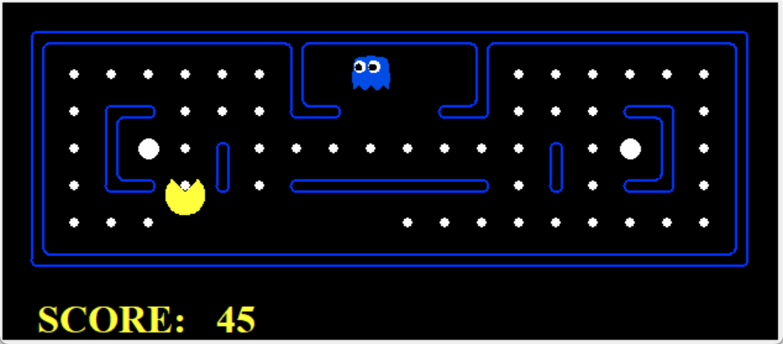
Question 5 (6 points): Evaluation Function
The evaluation function should evaluate states, rather than actions like your reflex agent evaluation function did.
You can use your search code in last project for evaluation.

